Slide 1
Water Damage Detection Robot
Early Prevention Through Smart Monitoring

Slide 2
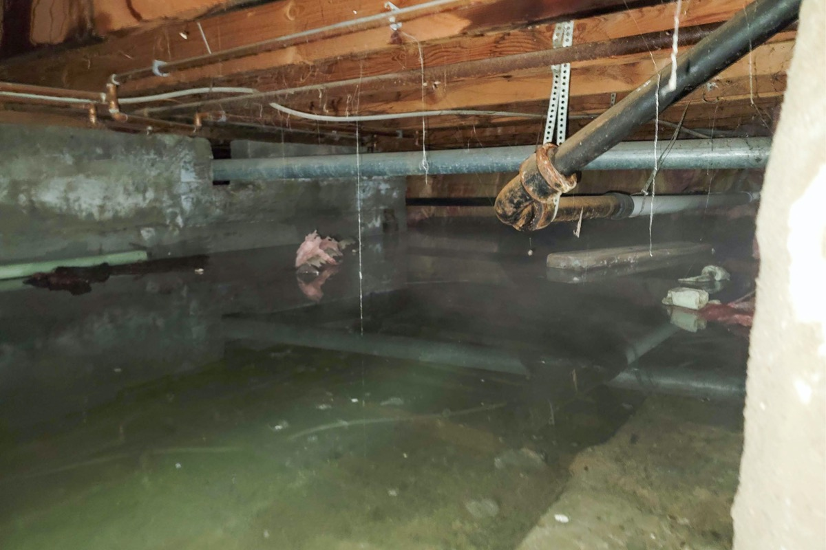
The Problem: Water damage is detected too late
$ BILLIONS
Current Approach: Reactive
Fix AFTER damage occurs
Repair costs:$15,000 - $30,000+
Insurance complications
Property damage
Mold and health hazards
In Annual insurance claims for water damage

Slide 3
Water Damage Timeline
JAN
Small leak starts
$0
FEB
Mold growing
$0
MAR
Visible damage
$500
APR
Major damage
$15,000
EARLY DETECTION WINDOW
2-3 month warning prevention possible
with minimal cost fix

Slide 4
The Gap: Why the current approach fails
Cameras:
Insurance Claims
Do not usually appear under the building
Is tedious and only pays after damage occurs
Manual Inspection
Infrequent, expensive, human dependent
Result: costly and reactive

Slide 5
Our Solution: Detection Robot
Autonomous robot + Smart analysis = Early warning
PATROL
ANALYZE
ALERT
🤖
📊
🚨
Autonomous crawl space monitoring
Trend-based and anomaly detection
Early warning for property manager
Result: 2-3 month early warning BEFORE expensive damage
Prevent mold & structural damage
Fix problems for $500 instead of $15,000
Property manager has peace of mind
Avoid insurance complications

Slide 6
Monthly Patrol Cycle
5 min
Deploy robot
30-40 min
Autonomous/Manual patrol
5 min
Retrieve & review
Instant
Alerts if detected
Property Manager Action:
If normal: 'Schedule next month'
If watch zone: 'Monitor closely next visit'
If alert: 'Call contractor immediately'

Slide 7
How Detection Works - 3 Phases
1: BASELINE
2: MONITOR
3: ALERT
First patrol = Normal
Compare each patrol
Anomaly detected
EXAMPLE TREND DETECTION FLOW:
EXAMPLE ANOMOLY DETECTION FLOW:
Month 1: Establish baseline → Humidity = 65% (normal)
Step 1: cold spot detected
Month 2: Humidity = 78% → Alert: +13% increase detected
Step 2: probe soil for moisture
Month 3: Humidity = 82% → Alert escalates: +17% increase, action needed
step 3: excess moisture found → alert: action needed
KEY INSIGHT: We detect TRENDS, not just readings
Slow increases = 2-3 month warning before damage

Slide 8
Hardware Components
ROBOT CHASSIS
SENSORS
🤖 Robot Body
💧 Humidity (±2%)
🔋 4-6 hour battery
🌡️ Temperature
⚙️ Motor control
🔴 Thermal Camera
📡WIFI Capable Controller
📍 GPS
Total Cost: ~$300

Slide 9
System Sensor Architecture
SENSORS:
Humidity
temperature
thermal
GPS
PROCESSING:
Data Collection
Baseline Learning
Trend Analysis
OUTPUT:
Alerts
Reports
Dashboard
Continuous cycle:
1. Robot collects sensor data every 10 seconds
2. Data stored locally (SD card) & uploaded (via WiFi) to remote data base
3. System compares current to baseline
4. Detects anomalies, Trends & generates alerts
5. Property manager receives report and takes action

Slide 10
Data Flow Diagram
ROBOT
Collects Data
LOCAL
SD Storage
CLOUD
Upload
COMPARE
to Baseline
ANALYSIS
Engine
DECISION
Logic
🚨 ALERT
Timestamp
Location
Severity
Property manager
Receives Report

Slide 11
Testing & Validation Results
WiFi dropout → SD backup (zero data loss)
ROBUSTNESS
PASS
Alert latency < 5 seconds
RESPONSIVENESS
PASS
100% data collection
REAL-TIME
PASS
All tasks concurrent (no blocking)
MULTITHREADING
PASS

Slide 12
Business Impact & ROI
WITHOUT DETECTION:
WITH OUR ROBOT:
Leak undetected
Early detection
Damage spreads
Problem prevented
Repair cost: $15,000
Repair cost: $500
Insurance hassles
No insurance claim
Tenant issues
Happy tenants
50-UNIT COMPLEX ROI
Robot: $200 | Prevents: $15,000 claim | Payback: < 1 month | Annual Savings: $30,000

Slide 13
Embedded Systems Excellence
🤖 AUTONOMOUS
📡 REAL-TIME
🛡️ ROBUST
Makes decisions without human input
Continuous 4+ hour monitoring
Works even if components fail
⚡ RESPONSIVE
📈 SCALABLE
💰 VALUABLE
Alerts generated in < 5 seconds
Works for 1 or 1000+ properties
Prevents real damage, saves money

Slide 14
Summary
Problem
Water damage: A top insurance claim, preventable
Solution
Can autonomously monitors crawl spaces monthly
Innovation
Trend analysis enables early warning
Impact
Prevents $15,000+ damage, saves property & money
Result
Proactive, scalable, profitable system

Slide 15
THANK YOU FOR WATCHING
Water Damage Detection and prevention Robot

